Slide 1

Name: Dylan Christopher Noonan
Educational Background:
Post Secondary Education
High School Education
Work Experience:
X-Patrol
Bulk Barn Foods
Volunteer Canvasser
More About You:
My Certifications
My Hobbies/Interests
Ahead Of The Game
X-Oceans Outreach Program

Slide 2
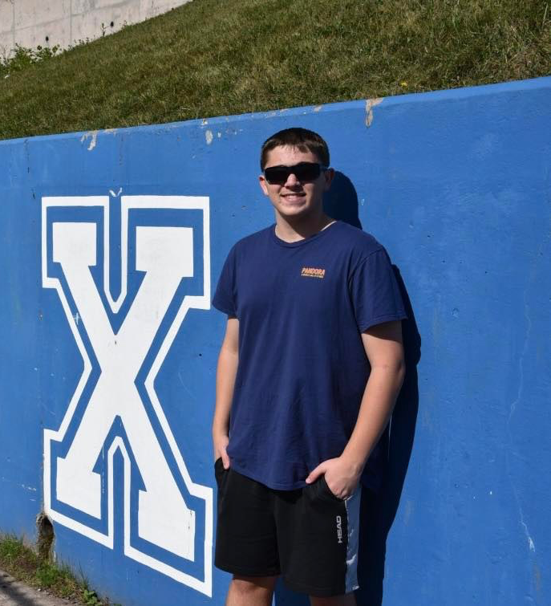

Educational background
Post-Secondary Education:
  St. Francis Xavier University (Bachelor of Business Administration) – Class of 2023
    Designated major in Marketing and minor in Sports Management
    Selected to represent the university as a member of the JDCC Business Strategy Competition Team for the 2022-2023 academic year
    Participated in the annual internal STFX business Case Study Competition (2020 and 2021 academic years)
    Nominated for a 2021 ‘Schwartz Business Society’ award (leadership/collaboration category)
    Awarded ‘Schwartz Scholar of Distinction’ and ‘Merit Entrance’ Scholarships upon admittance in 2019

Slide 3
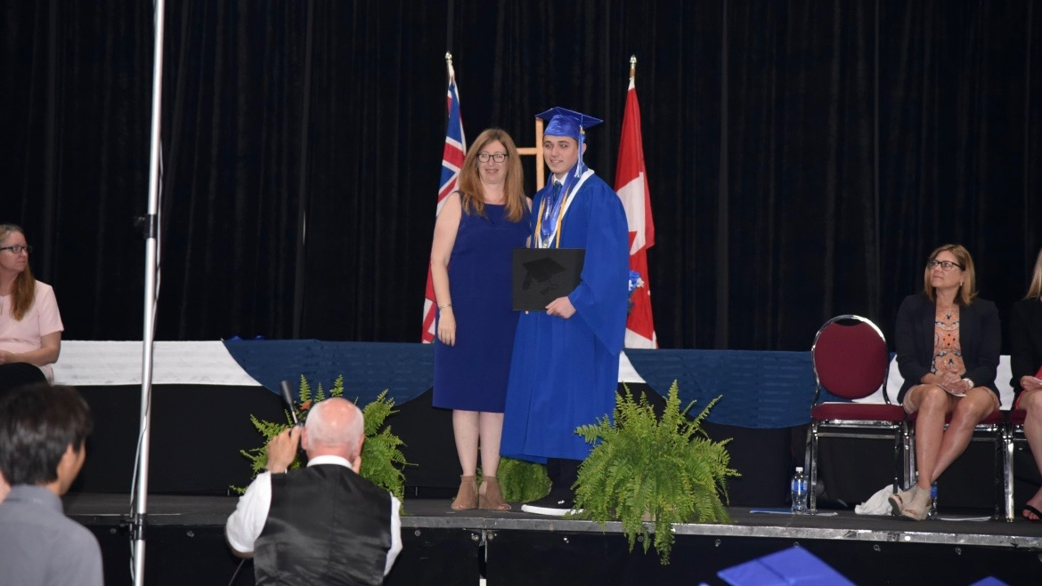

Educational background
High School Education:
  St. Peters Catholic High School (French Immersion Program) – Class of 2019
    Graduated with ‘Ontario Scholar’ and ‘Honor Roll’ designations for high academic achievement
    Received ‘Business Education Certificate’ and ‘Diploma for French Studies’
    Awarded both ‘Jazz Leadership’ and ‘Athletic Leadership’ medals
    Based on positive endorsements by faculty/peers, chosen as one of a small number of graduating students to be an ”SPK Leader” during the 2018-19 academic year to organize and execute a variety of large-scale events for the entire school population
  Blyth Academy
    Completed advanced mathematics courses within the 2017-2018 academic years to enrich academic standing in preparation for university studies

Slide 4
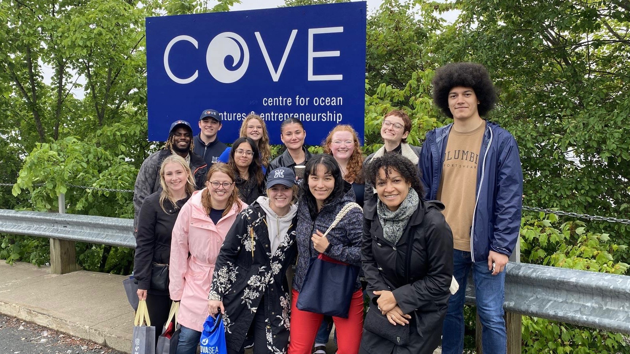
X-Oceans outreach program
Tasked with enhancing the ocean education and ocean stewardship to the youth through STEM and experiential learning in Northeastern Nova Scotia.
Responsible for growing the X-Oceans social media platforms (ie: TikTok, Facebook, Twitter, Instagram, YouTube, etc...) while increasing retention and viewers.
Responsible for creating and implementing promotional campaigns for the X-Oceans outreach program.
Tasked with managing educational events within the Antigonish / local community to enhance the education of the youth while increasing their interest in protecting our environment.

Slide 5

Ahead Of The Game
Research Analyst (Sports Management Program; St. F.X. University; Antigonish, NS) - 2023 to Present - Conducting research and analytical activities for the “Ahead of the Game Youth Program”
  Leading information-gathering exercises pertaining to the overall functioning of various aspects of the above- noted organization (such as on-boarding programs, employee management, marketing techniques, partnerships, structural design, organizational behaviour, finances, performance management) and providing advice/ recommendations to senior leaders regarding opportunities for improvement
  Managing a $40,000 budget to create a viable/reliable business plan to address strategic issues and devise appropriate solutions within the organization to gain efficiencies and improve overall performance

Slide 6
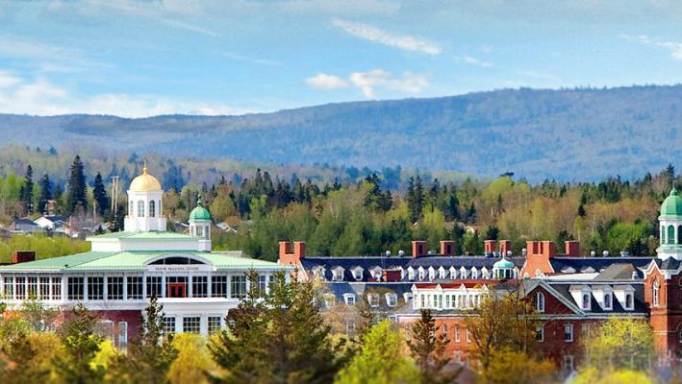
X-Patrol Senior Officer
X-Patrol Officer (Campus Security Team STFX University; Antigonish, NS) -2021 to Present
  Helping to maintain a safe and secure campus environment by carrying out regular patrols and surveillance activities, reporting suspicious activities, facilitating dispute resolution, and intervening in emergent issues in a positive/constructive manor
  Completing official reporting requirements related to on-campus security incidents and initiating follow-up actions
  Working in partnership with other campus security personnel and local law enforcement organizations

Slide 7

Customer Service Representative
Bulk Barn Foods (Customer Service Representative/Cashier/Inventory Clerk; Ottawa, ON) – 2021 and 2022
  Provided efficient and courteous service to a diverse range of clients within a fast-paced retail operation
  Handled large volumes of currency and digital financial transactions on a daily basis to complete client orders expeditiously and maintain careful records of inventory/sales volumes for business purposes
  Replenished product inventories on a regular basis and assisted with tracking of existing stock levels/reordering

Slide 8
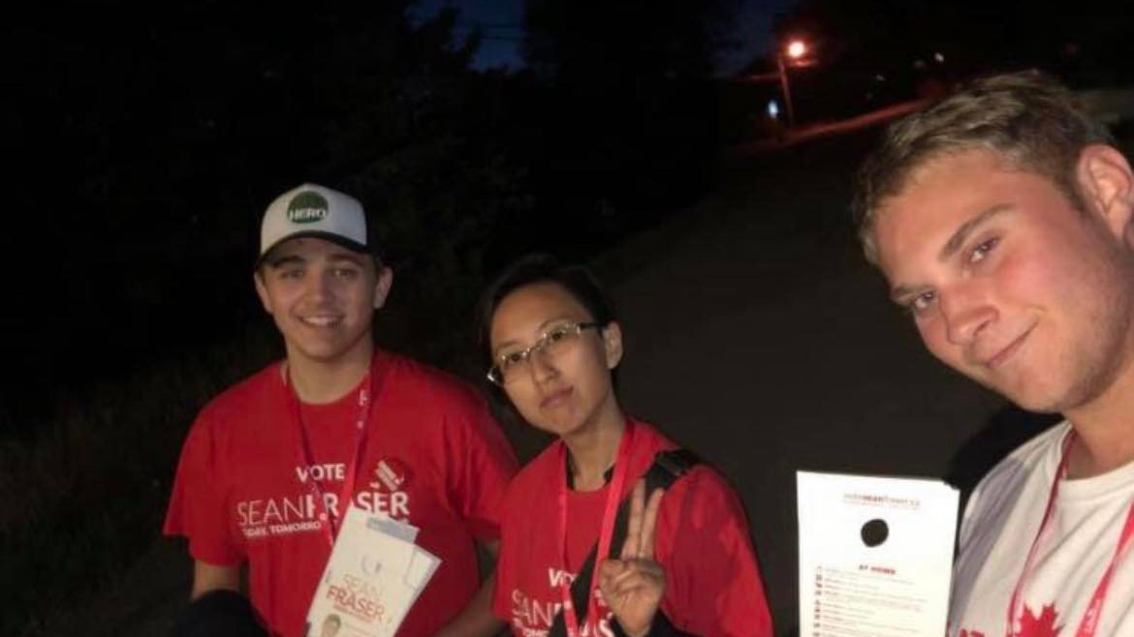
volunteer Experience
Volunteer Election Canvasser (Antigonish, NS) – 2019 / 2020 Academic Year
  Conducted canvassing activities for a local candidate in a recent federal election by contacting potential voters door-to-door and via telephone to discuss policy/program priorities and generate support for the candidate
  Carried out administrative and office support activities to help advance throughout the campaign

Slide 9
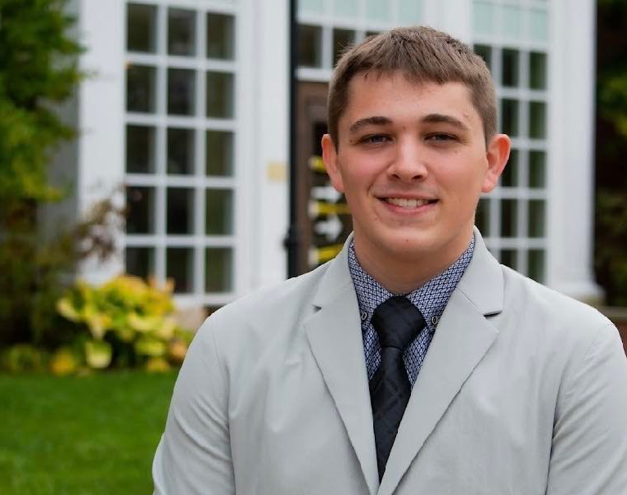
More about me
Received First-Aid Certification in the 2021-2022 academic year
Completed suite of progressive training and certification courses in the 2022-2023 academic year
  Mindfulness
  Anti-Black Racism
  Waves of Change
  Mental Health
  Disclosure Training
Well developed communication and problem-solving skills
Technological Aptitude/Digital Savvy (Word, PowerPoint, Excel)
Business acumen and team-building orientation (Strong leadership and collaboration competencies)

